Slide 1
Visualizing and building statistical models on multivariate data in R
Anthony Fodor
Bioinformatics and Genomics
UNC Charlotte
http://fodorclasses.github.io/classes/ChapelHill2019/ch.pptx

Slide 2
I am assuming that you have installed…
Some version of R
Some text editor (sublime is a very nice choice, or e-macs or vi or r-studio)

Slide 3
Normalizing your data
PCA Ordination
Graphing everything into one big PDF ball
Some Simple Statistical Models
Some Not So Simple Statistical Models

Slide 4

If you are following along with our datasets…
We will be using the data from this paper…
https://microbiomejournal.biomedcentral.com/articles/10.1186/s40168-017-0338-7

Slide 5
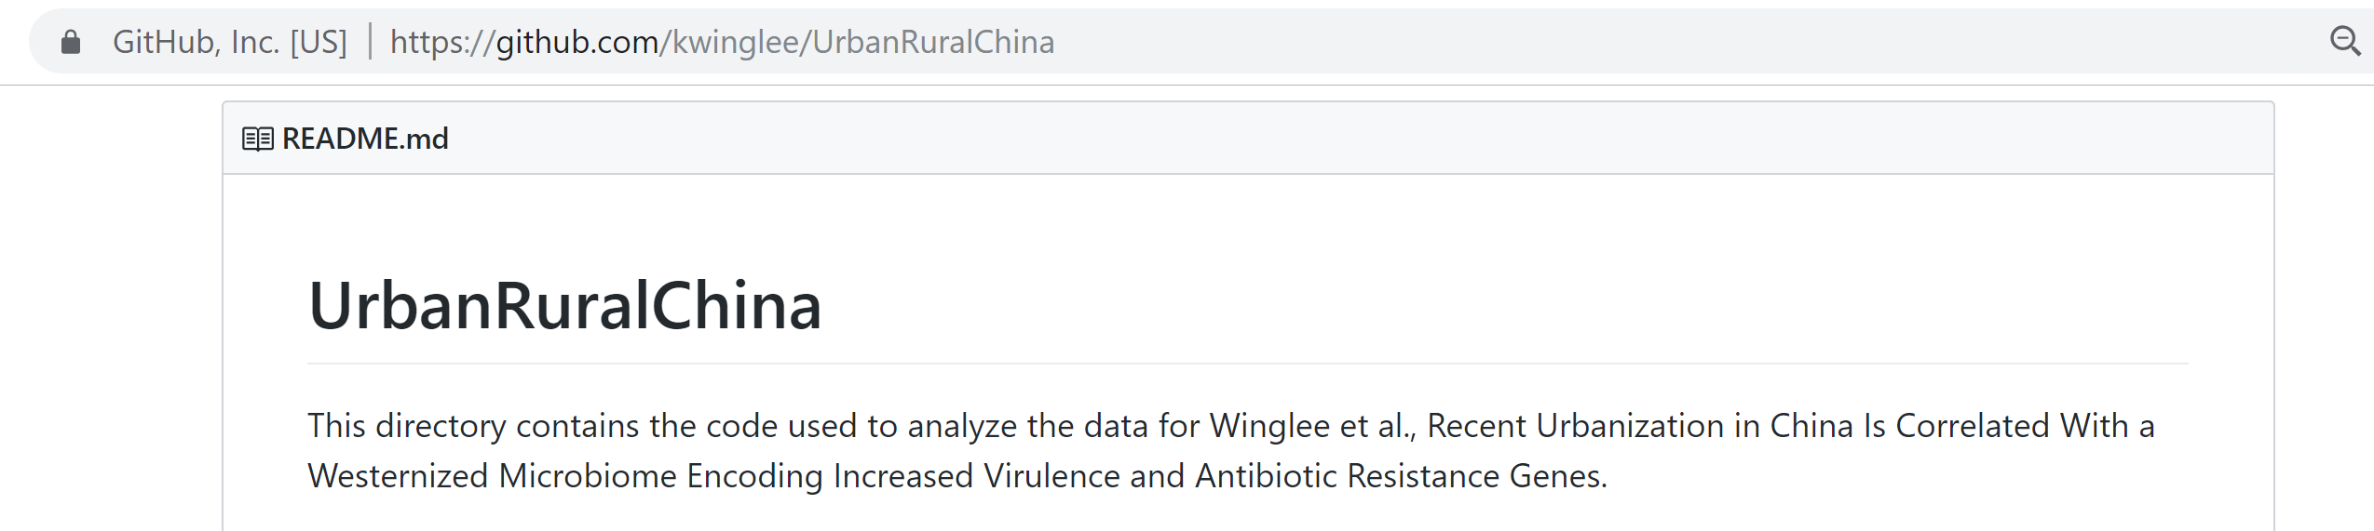
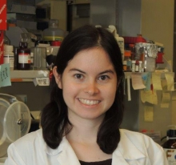
Tables and r-scripts were nicely organized by Kathryn Winglee (now of the CDC in Atlanta)
https://github.com/kwinglee/UrbanRuralChina

Slide 6
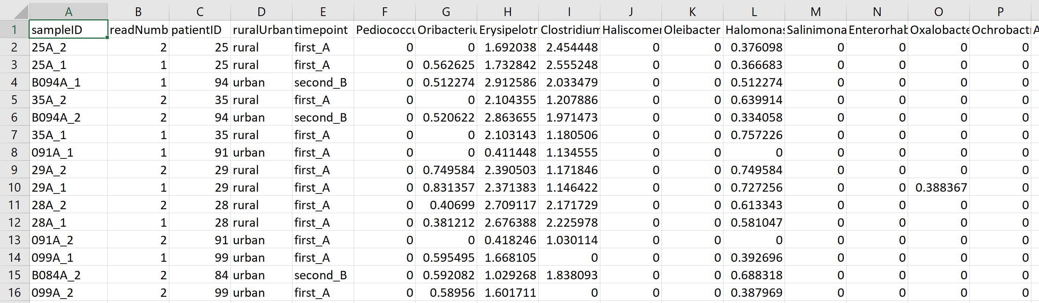
We will use this spreadsheet as our base input into R…
https://github.com/kwinglee/UrbanRuralChina/blob/master/16SrRNA/inputData/RDP/genus_taxaAsColumnsLogNorm_WithMetadata.txt

Slide 7
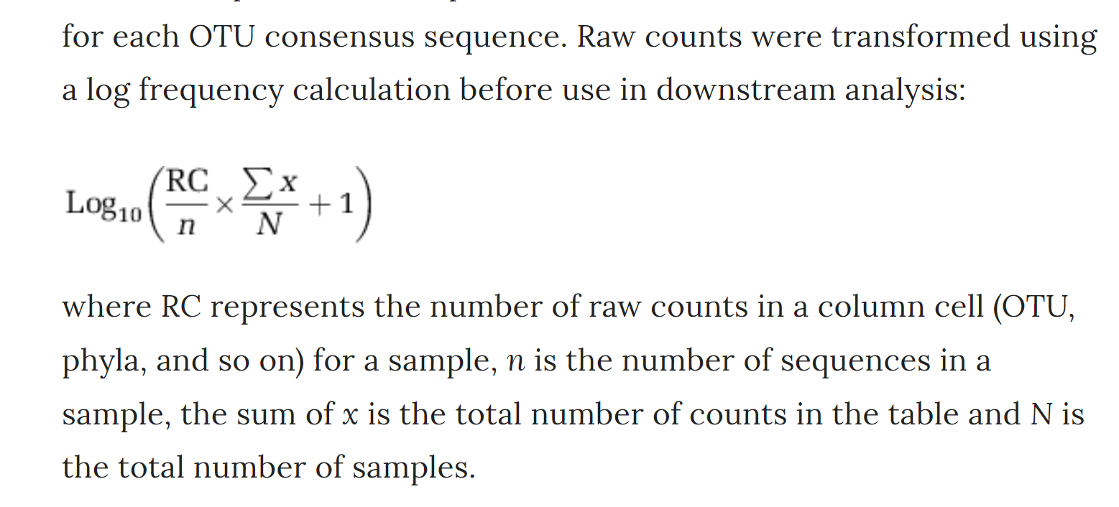
This spreadsheet has the following features:
The taxa are columns; the rows are samples
The metadata (urban vs. rural, timepoint) are in the same spreadsheet as the relative abundance
The counts are log-normalized according to the following formula
https://www.nature.com/articles/ismej2013106
Often, the most important decision you will make in analysis is whether to log-transform your data
(my lab usually does)

Slide 8
If you have your own dataset…
We can work with you to get your data into the same format
(or to modify your R code to work with your table!)

Slide 9
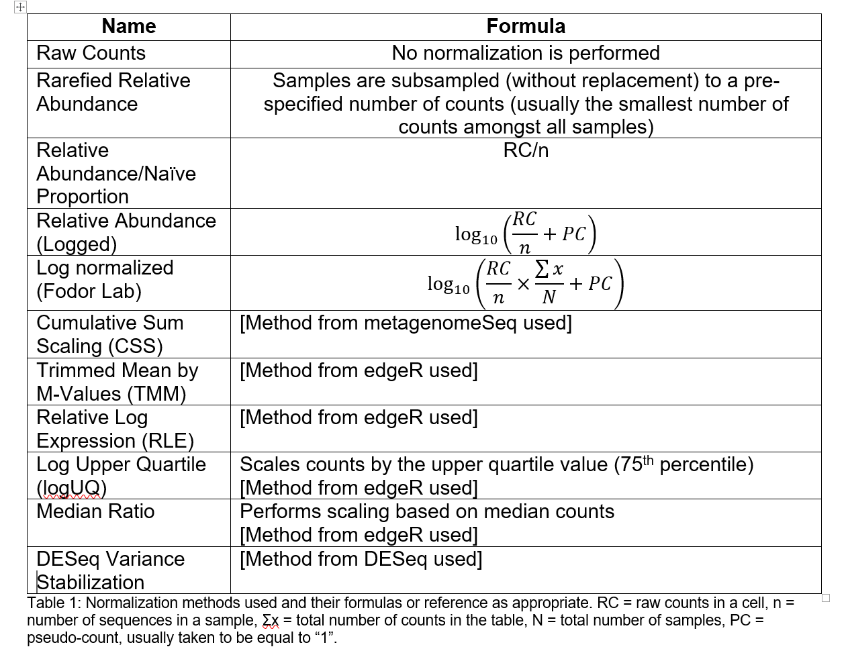
You will need to choose some normalization scheme..
(Each sequence library will be of a different depth; you need to correct for that)
The easiest (not necessarily the best) approach is to divide each cell by the total # of sequences in that sample.
This is relative abundance
Table due to :Matthew C. B. Tsilimigras (Matthew C. Brown)

Slide 10
Normalizing your data
PCA Ordination
Graphing everything into one big PDF ball
Some Simple Statistical Models
Some Not So Simple Statistical Models

Slide 11
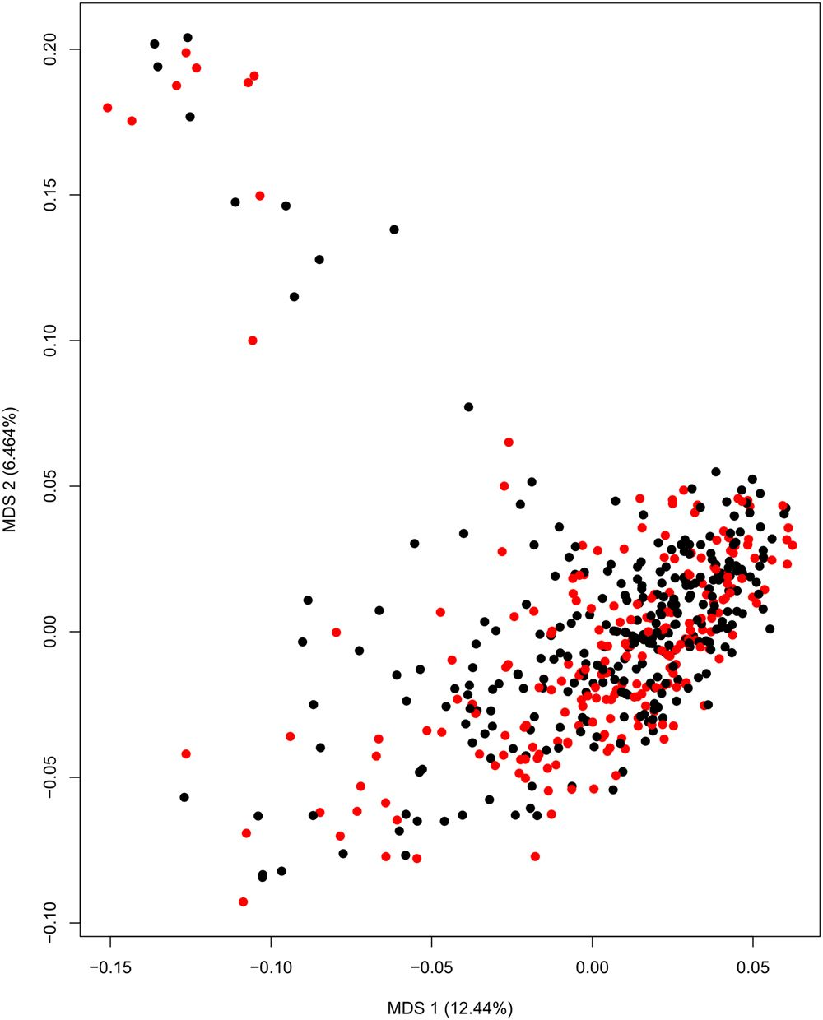
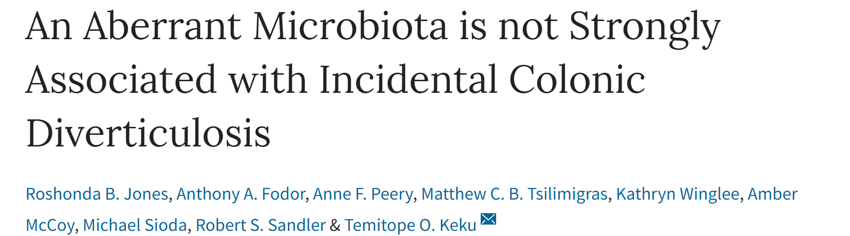
Nearly every manuscript published on the microbiome has an ordination figure…

Slide 12
There are about 340 taxa in our spreadsheet.
We can’t make a 340 dimensional graph
We can use ordination to reduce the dimensionality (and complexity of our dataset)

Slide 13
We can use ordination to reduce the dimensionality of our complex data
We can go from a (20 * 340 ) spreadsheet to a ( 20* 2 ) spreadsheet.
This will allow us to better see what is going on with our data…

Slide 14
Ordination is a form of data compression
We know data compression from music and photos…
A song on a CD might be 350 MB (megabytes) big.
But we compress the song to an MP3 for our phone so that is only, maybe 6 MB big.
The compression captures what is essential about the song, but in less space.
Potentially, the more we compress, the worse the song sounds!
Our ordination attempts to capture what is essential in our ~340 taxa, but in 2 columns.
We can do this by taking advantage of duplicate information.
Imagine all the 340 taxa are highly correlated. We could remove the extra information
from those columns and still have all the important information in the spreadsheet with much less space…
( A more mathematical treatment describing the
compression is here: http://afodor.github.io/classes/stats2015/Lecture19.pptx )

Slide 15
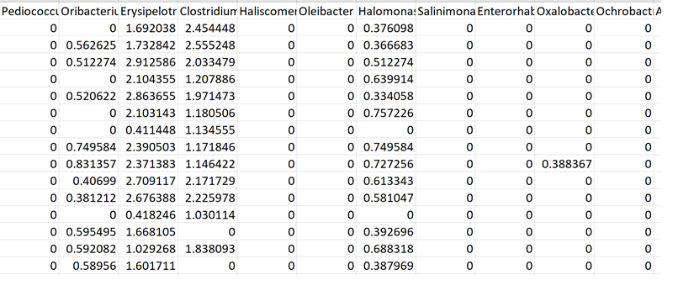
Ordination works by forming some sort of correlation matrix.
You measure how similar each sample is to each other and describe the similarity in a
“symmetrical” (sometimes called Hermitian) square matrix.
Make a square symmetrical (“Hermitian”)
distance matrix showing how related all the taxa are
Find the eigen-vectors of the square matrix
Start with your data
Project your data into the eigen-value basis
The biggest choice is how will you measure the distance between each taxa.
PCA uses covariance or Pearson correlation
But in microbiome the most popular choices are Bray-Curtis and unifrac.
My lab usually uses Bray-Curtis (because it is much simpler than unifrac)

Slide 16
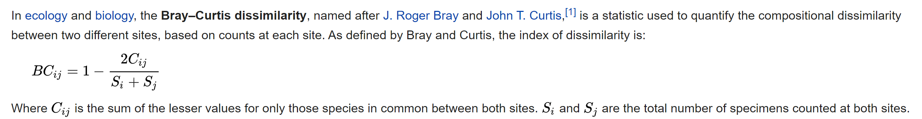

Slide 17
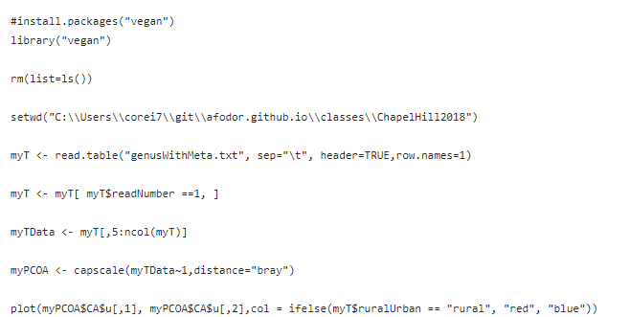
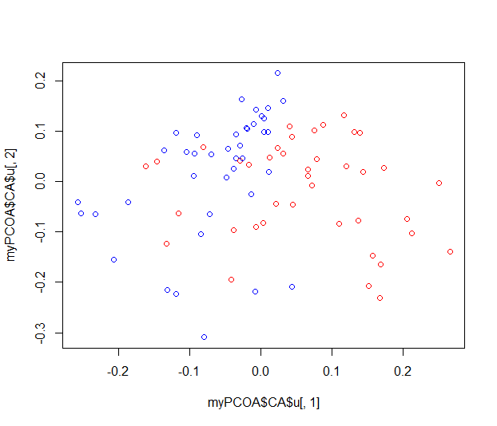
Here is a complete script for data ordination from a (in this case) log-normalized data file…
https://github.com/afodor/metagenomicsTools/blob/master/src/classExamples/ch2018/quickOrdination.txt

Slide 18
The library that will run our ordination. Uncomment this the first time
you run your program to download and install the program
https://github.com/afodor/metagenomicsTools/blob/master/src/classExamples/ch2018/quickOrdination.txt

Slide 19
This line tells R to load the “vegan” library into memory
https://github.com/afodor/metagenomicsTools/blob/master/src/classExamples/ch2018/quickOrdination.txt

Slide 20
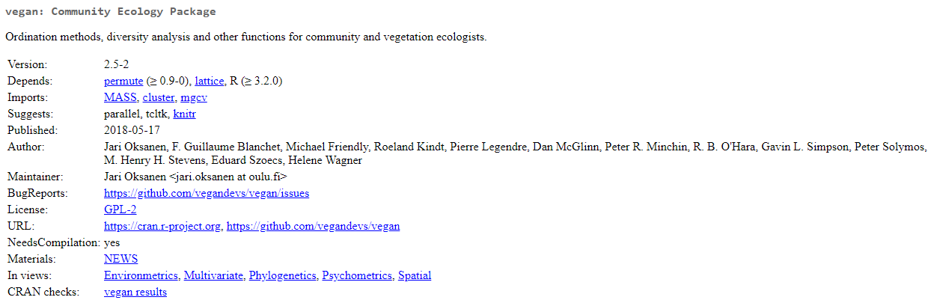
The vegan package has many useful tools for dealing with ecology count data
(like sequencing data from metagenomics)

Slide 21
We start R in a clean state (we would not do this if this were part of a larger suite)
https://github.com/afodor/metagenomicsTools/blob/master/src/classExamples/ch2018/quickOrdination.txt

Slide 22
And we tell R where we have the data
(this can alternatively be a URL)
https://github.com/afodor/metagenomicsTools/blob/master/src/classExamples/ch2018/quickOrdination.txt

Slide 23
we read our data into R
https://github.com/afodor/metagenomicsTools/blob/master/src/classExamples/ch2018/quickOrdination.txt

Slide 24
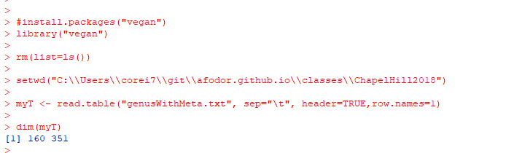
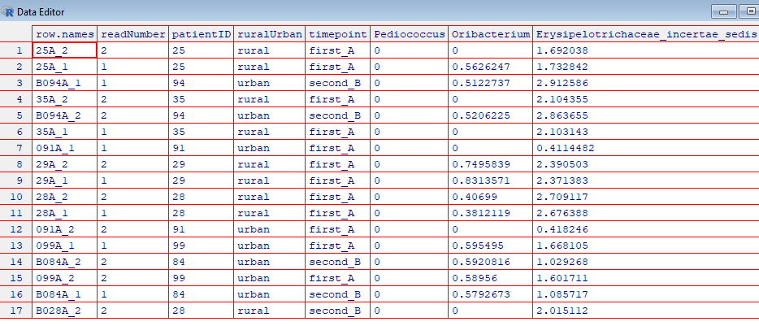
At this point in our program, our spreadsheet has 160 samples (rows) and > 340 taxa (columns)
edit( myT)
This spreadsheet
has both the forward
and backwards reads;
We want to filter out
the forward reads

Slide 25
Here we only keep the rows where the readNumber == 1
https://github.com/afodor/metagenomicsTools/blob/master/src/classExamples/ch2018/quickOrdination.txt

Slide 26
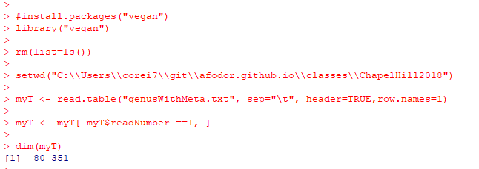
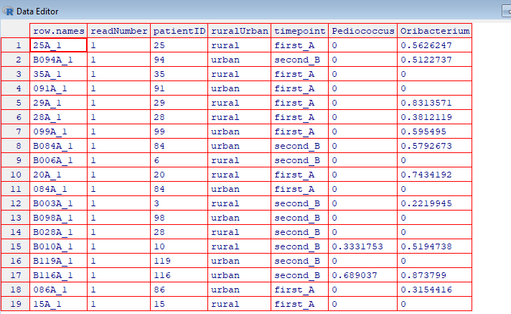
After we filter, only the rows for which the readNumber was 1 are left…
edit(myT)

Slide 27
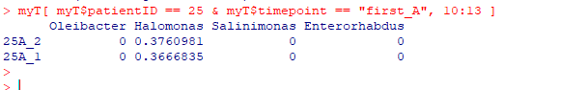
The ability to quickly subset data tables is one of the most powerful features of R
Return columns 10-13
for one subject at one timepoint

Slide 28
Here we separate the data we want to ordinate from the first
4 columns of metadata
https://github.com/afodor/metagenomicsTools/blob/master/src/classExamples/ch2018/quickOrdination.txt

Slide 29
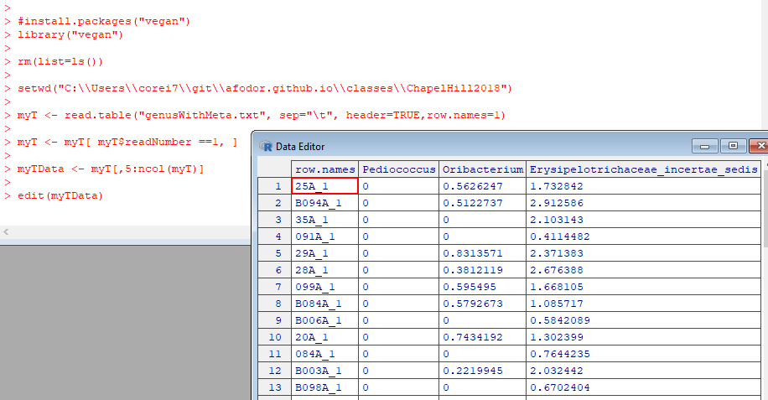
Return all
but the first 4
columns

Slide 30
Here we do the ordination/data compression
https://github.com/afodor/metagenomicsTools/blob/master/src/classExamples/ch2018/quickOrdination.txt

Slide 31
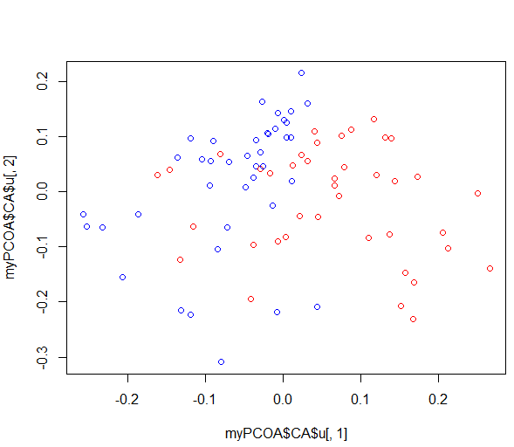
And plot the results
https://github.com/afodor/metagenomicsTools/blob/master/src/classExamples/ch2018/quickOrdination.txt

Slide 32
This graph is not quite publication ready….

Slide 33
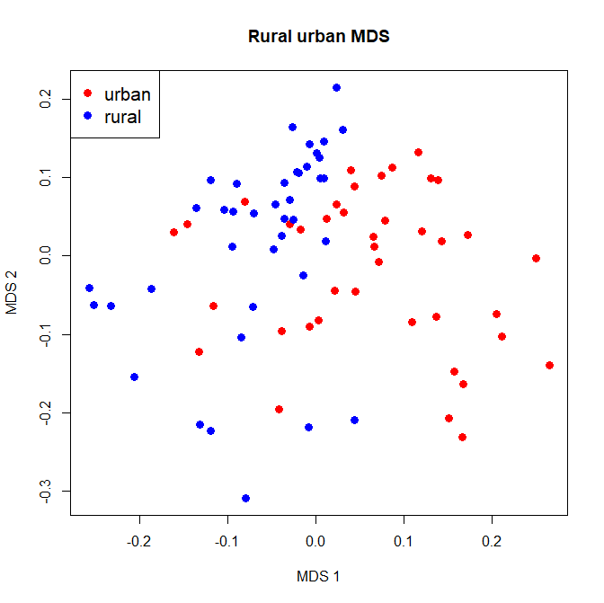
plot(myPCOA$CA$u[,1], myPCOA$CA$u[,2],col = ifelse(myT$ruralUrban == "rural", "red", "blue"),xlab="MDS 1", ylab="MDS 2", main="Rural urban MDS", pch=19,cex=1.3)
legend( "topleft", legend=c("urban", "rural"), col=c("red","blue"), pch=19,cex=1.3 )
We can pass options to our plot function to make the graph a little easier to see and a legend
Google searches help us find these commands

Slide 34
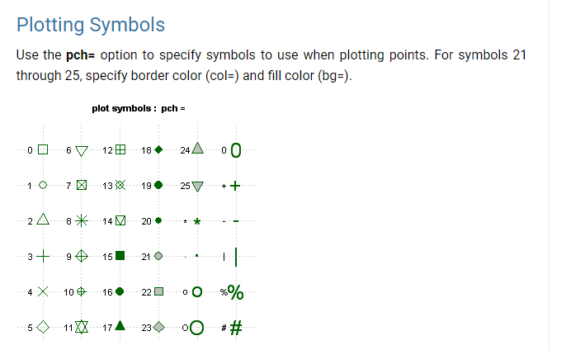
https://www.statmethods.net/advgraphs/parameters.html

Slide 35
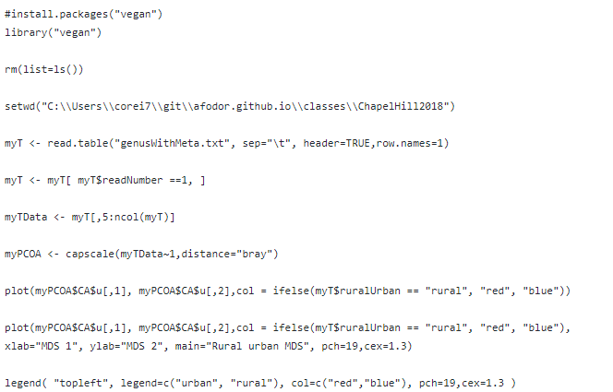
Here is our script so far…
https://github.com/afodor/metagenomicsTools/blob/master/src/classExamples/ch2018/quickOrdination.txt

Slide 36
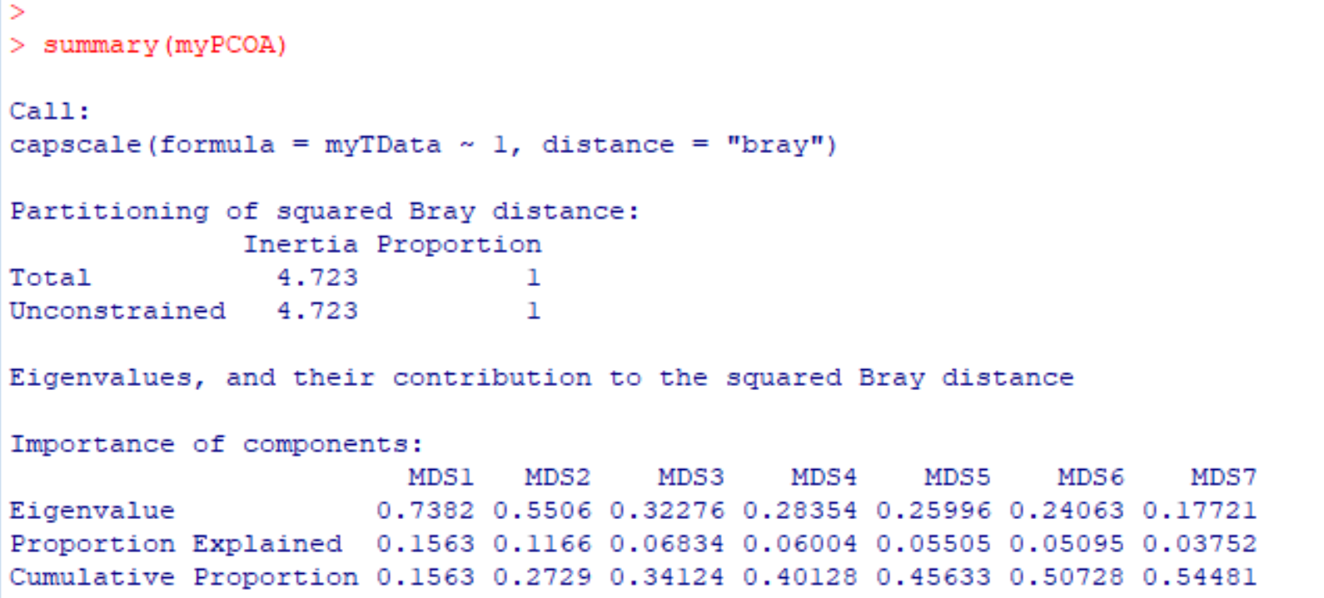
We can make one more refinement. How much duplicate information was there in the taxa?
That is, how much were the taxa correlated? How good was our compression?
We can use the “summary” command and R will yield this information…
more details at http://afodor.github.io/classes/stats2015/Lecture19.pptx

Slide 37
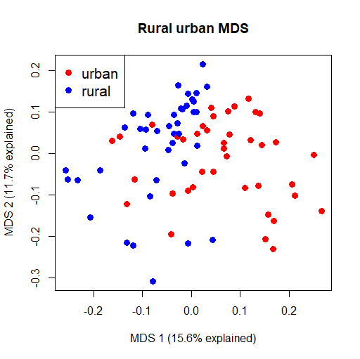
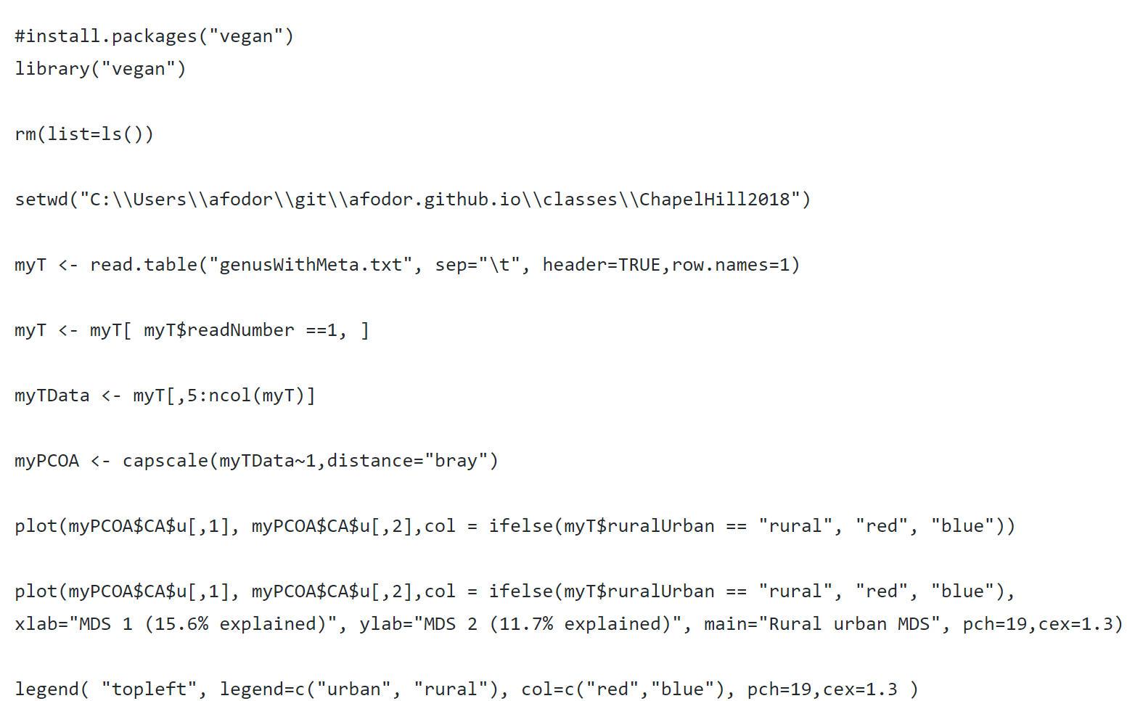
We can (in this case manually) add this to our graph script…
https://github.com/afodor/metagenomicsTools/blob/master/src/classExamples/ch2018/quickOrdination.txt

Slide 38
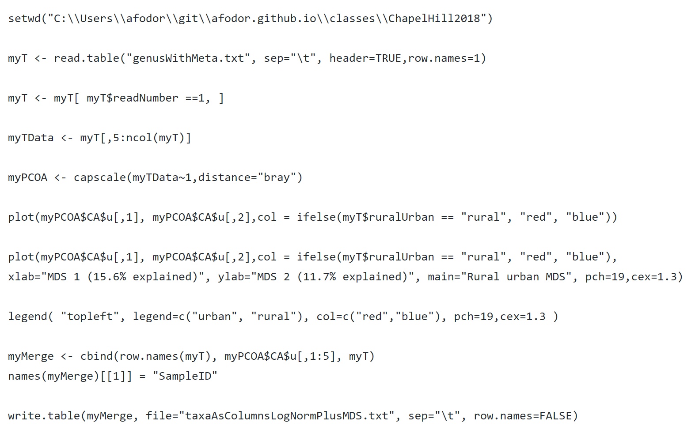
And, finally, we might want to write one file with the metadata, taxa information and MDS axes…

Slide 39
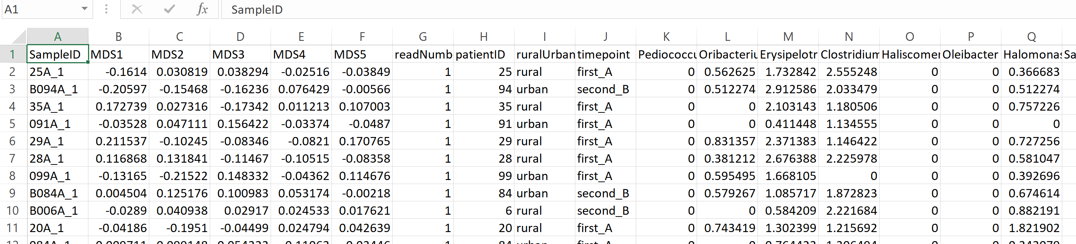
This is now ready to be inputted into any application (or read in by the next R script….)

Slide 40

Using ordination on metagenomics data is not without controversy…
This paper argues that different distance metrics make different assumptions about mean-variance
relationships, and hence you can think you are looking at a difference in means between two groups but
really it is a difference in variance…
This is interesting (and worthy of study) but in practice reviewers are unlikely to give you too much trouble…
These authors recommend approaching datasets taxa by taxa (or gene by gene), which is what we will turn to next..

Slide 41
Normalizing your data
PCA Ordination
Graphing everything into one big PDF ball
Some Simple Statistical Models
Some Not So Simple Statistical Models

Slide 42
We have a number of “metadata” columns in our spreadsheet that we might be interested in…..
Before we start to build statistical models, it would be useful to be able to graph out the entire spreadsheet.
The ability to make visualizations of very complex datasets is one of the great strengths of R.
We are going to make a multi-page PDF “ball” where each page of the PDF is an MDS axes (or taxa)
graphed out against all of the metadata

Slide 43
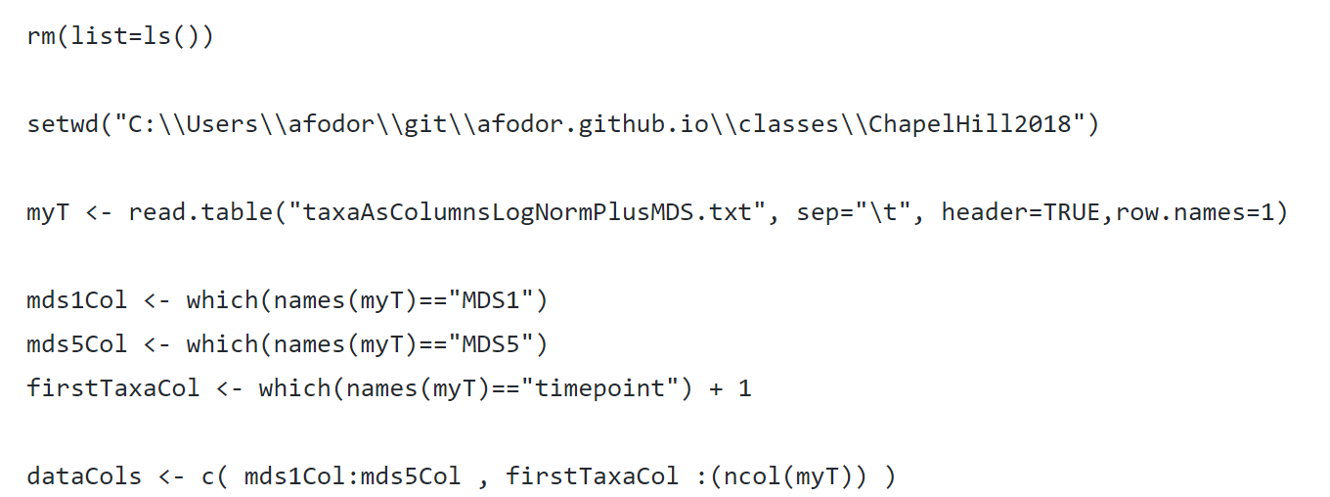
We start by defining which columns in our spreadsheet we will want to be on our y axes
(Input file for this section can be found at
https://github.com/afodor/metagenomicsTools/blob/master/src/classExamples/ch2018/pdfBall.txt

Slide 44
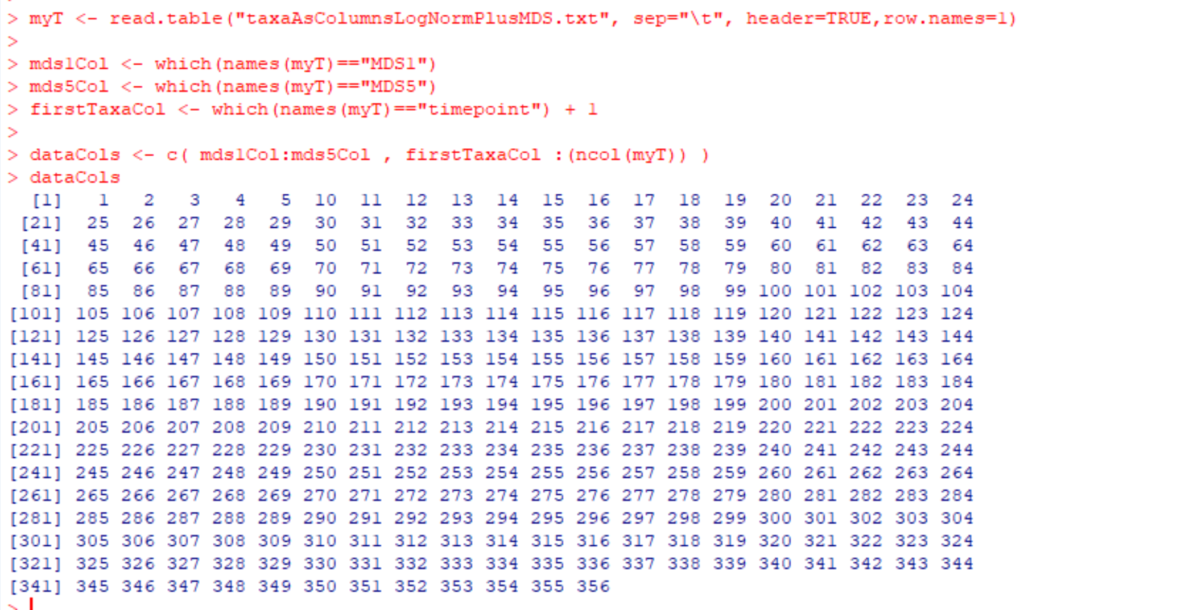
There are about 350 columns that we are interested in (but as we will see we will filter some of those away)

Slide 45
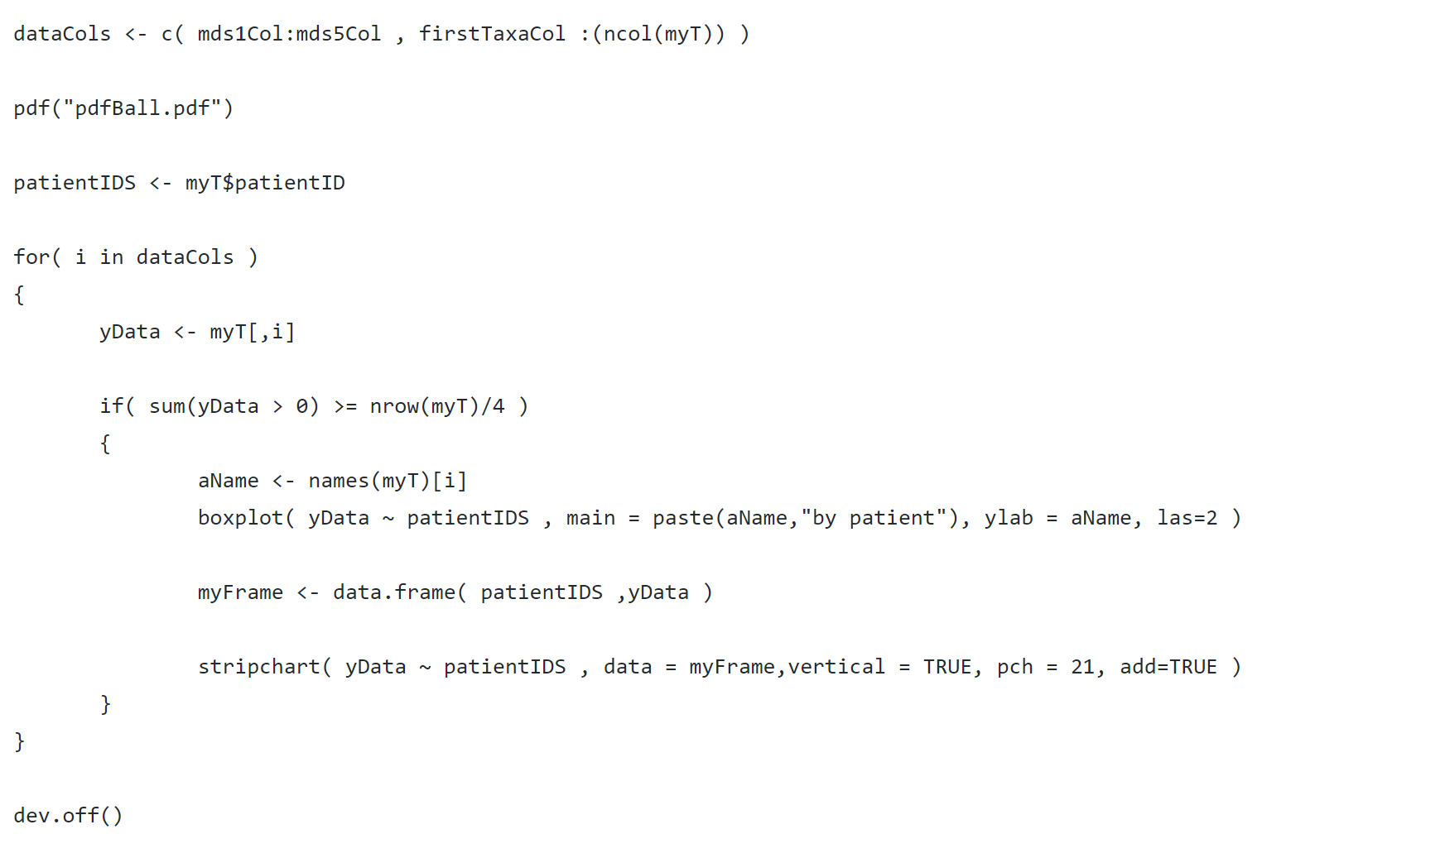
Here is a script to make a “PDF ball” of all of our data columns vs. subject id
Open up a PDF file for writing in our output directory
https://github.com/afodor/metagenomicsTools/blob/master/src/classExamples/ch2018/pdfBall.txt

Slide 46
Here is a script to make a “PDF ball” of all of our data columns vs. subject id
Remember the patientIDs (will be our x-axis)
https://github.com/afodor/metagenomicsTools/blob/master/src/classExamples/ch2018/pdfBall.txt

Slide 47
Here is a script to make a “PDF ball” of all of our data columns vs. subject id
Iterate over our data columns
https://github.com/afodor/metagenomicsTools/blob/master/src/classExamples/ch2018/pdfBall.txt

Slide 48
Here is a script to make a “PDF ball” of all of our data columns vs. subject id
Select out the ith column for our y-axis
https://github.com/afodor/metagenomicsTools/blob/master/src/classExamples/ch2018/pdfBall.txt

Slide 49
Here is a script to make a “PDF ball” of all of our data columns vs. subject id
Only taxa that are at least 25% non-zero
https://github.com/afodor/metagenomicsTools/blob/master/src/classExamples/ch2018/pdfBall.txt

Slide 50
Here is a script to make a “PDF ball” of all of our data columns vs. subject id
The name of our y-axis
https://github.com/afodor/metagenomicsTools/blob/master/src/classExamples/ch2018/pdfBall.txt

Slide 51
Here is a script to make a “PDF ball” of all of our data columns vs. subject id
Make the box-plot
https://github.com/afodor/metagenomicsTools/blob/master/src/classExamples/ch2018/pdfBall.txt

Slide 52
Here is a script to make a “PDF ball” of all of our data columns vs. subject id
Important: tell R to close the PDF file
https://github.com/afodor/metagenomicsTools/blob/master/src/classExamples/ch2018/pdfBall.txt

Slide 53
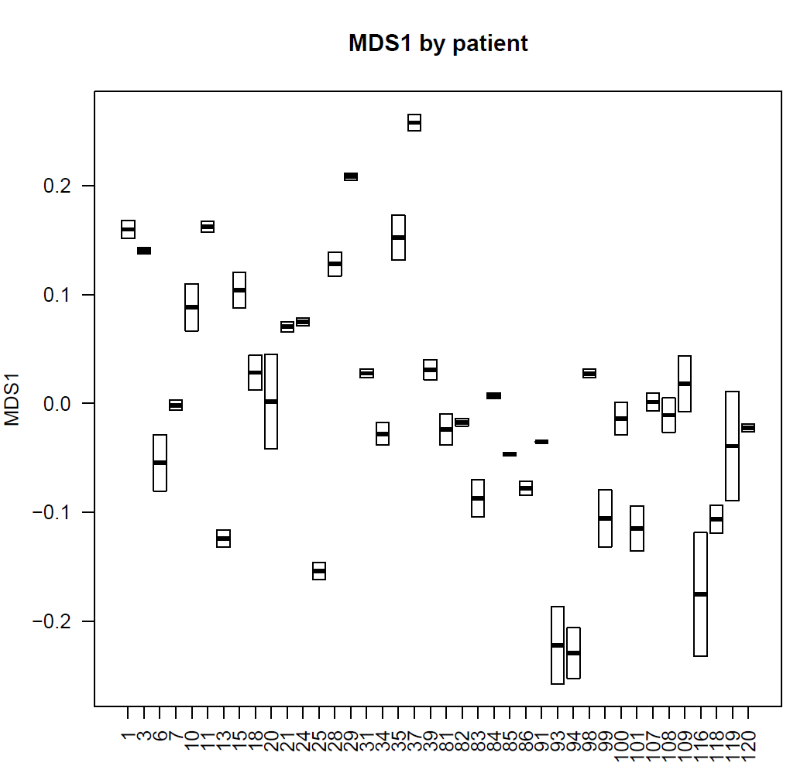
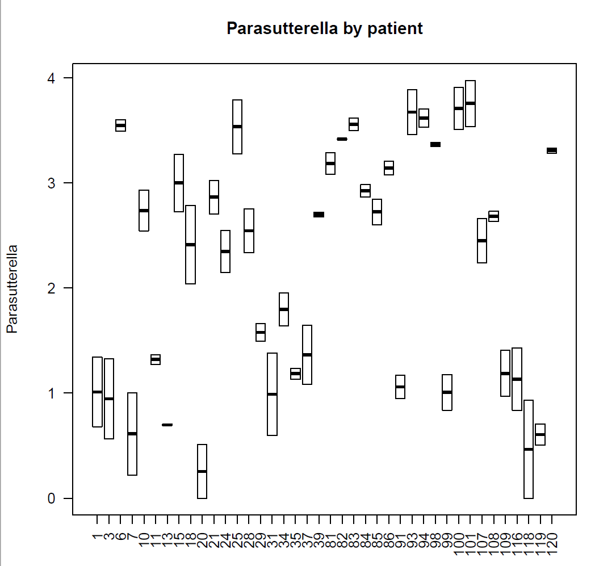
We end up with a 91 page PDF ball that shows the MDS axes and taxa graphed by subject ID.
We see a strong subject-effect. The tendency of the microbiome to be stable over the two time points.

Slide 54
With a few more lines of “stupid R tricks”, we can actually add the datapoints to the boxplots…
https://github.com/afodor/metagenomicsTools/blob/master/src/classExamples/ch2018/pdfBall.txt

Slide 55
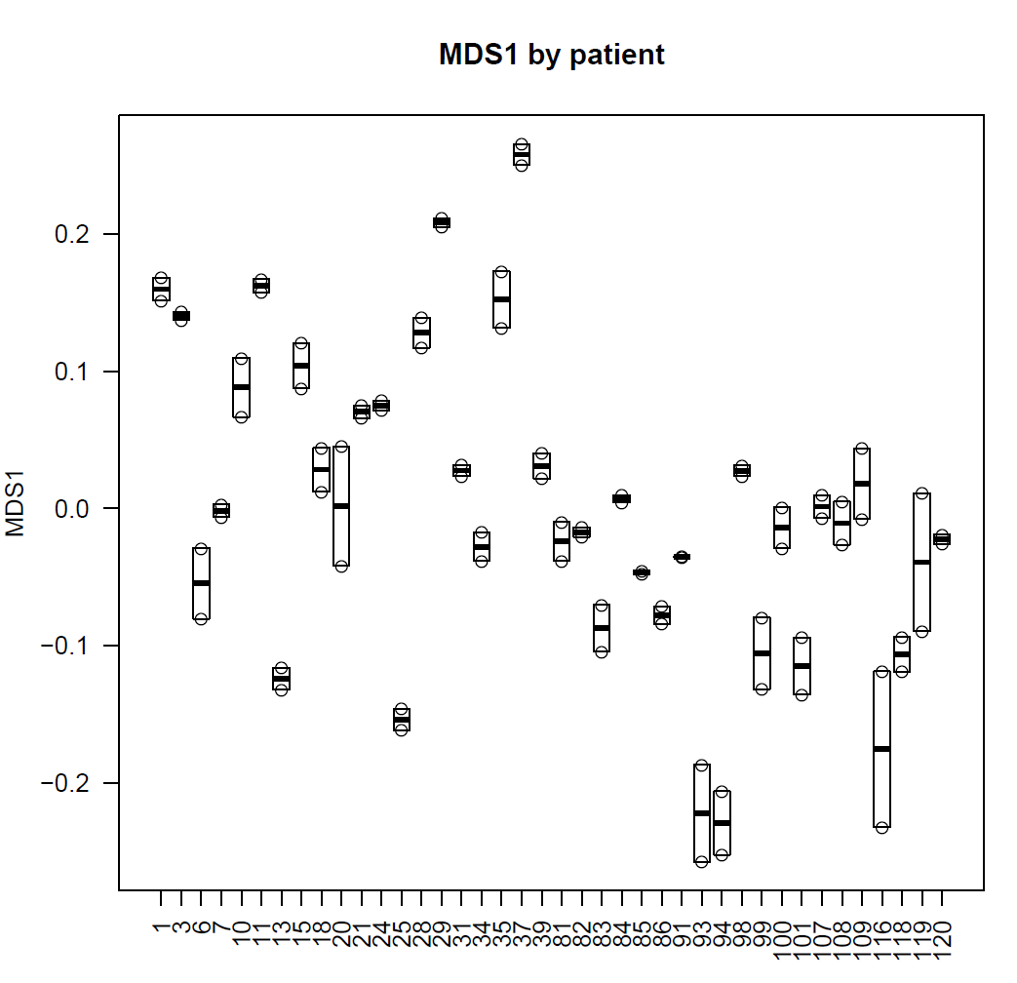
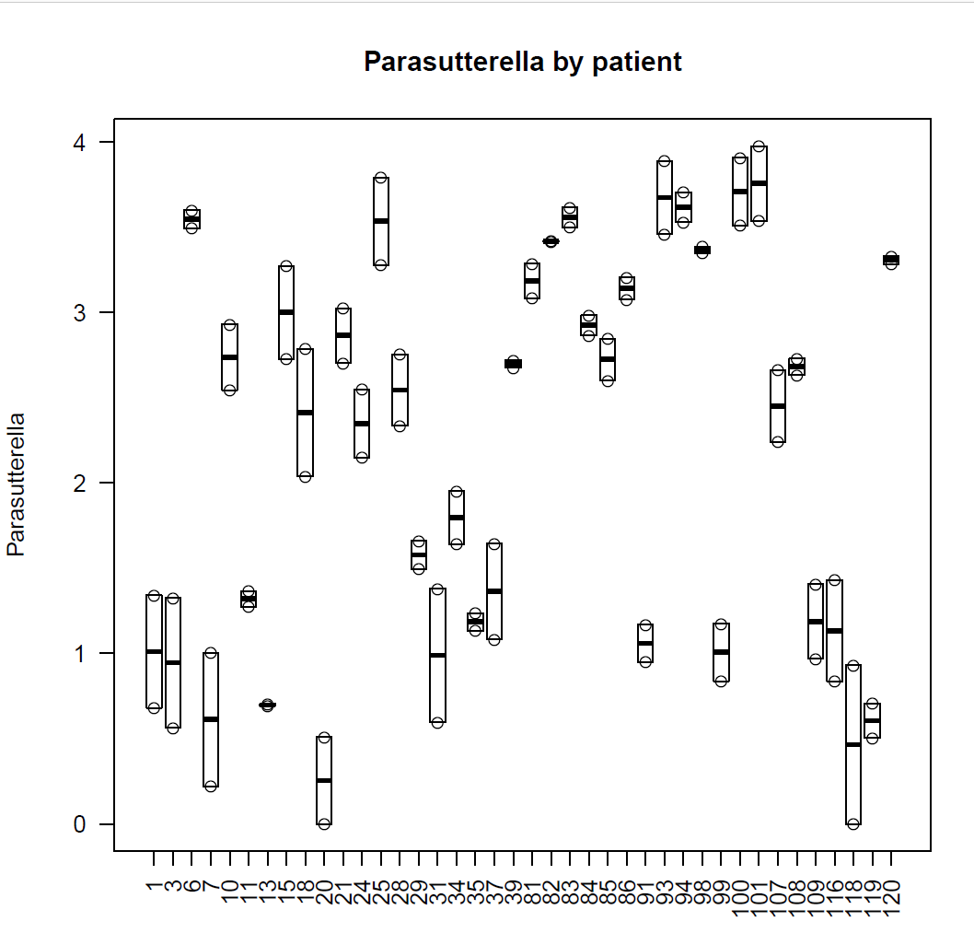
With a few more lines of “stupid R tricks”, we can actually add the datapoints to the boxplots…

Slide 56
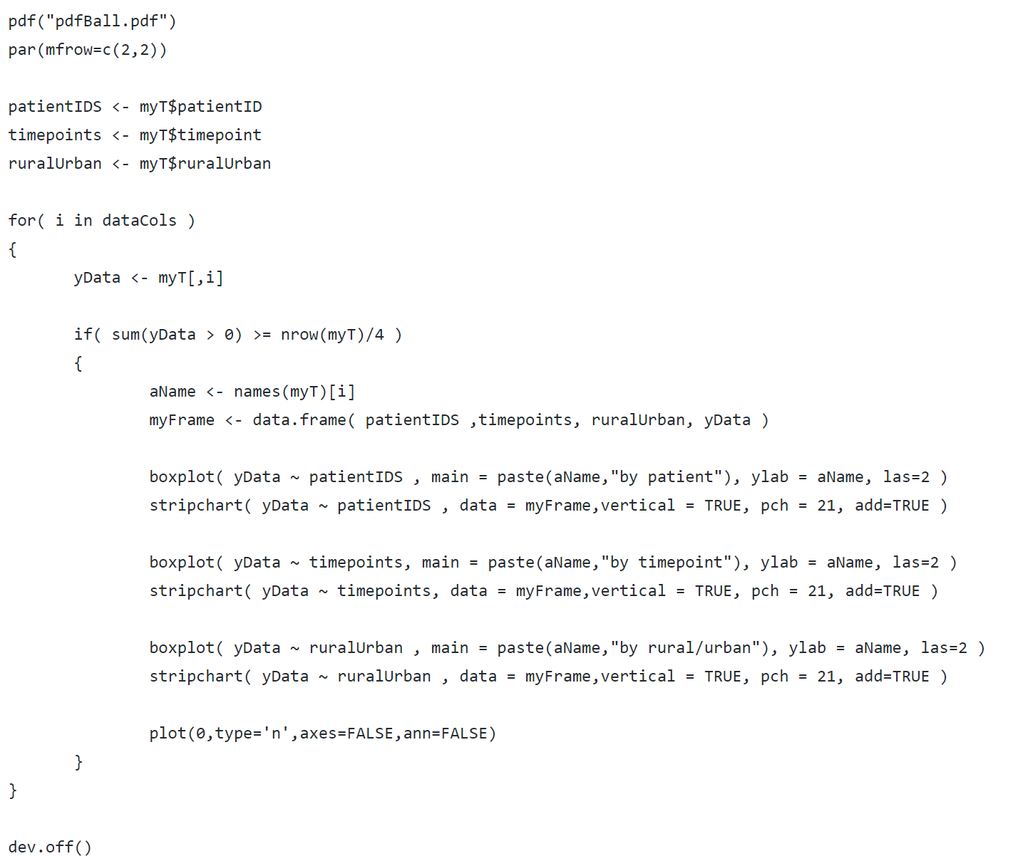
We can easily extend our boxplots to the other metadata in our file..
https://github.com/afodor/metagenomicsTools/blob/master/src/classExamples/ch2018/pdfBall.txt

Slide 57
We can easily extend our boxplots to the other metadata in our file..
Do 4 graphs per page
https://github.com/afodor/metagenomicsTools/blob/master/src/classExamples/ch2018/pdfBall.txt

Slide 58
We can easily extend our boxplots to the other metadata in our file..
Plot vs. subject
Plot vs. timepoint
Plot vs. rural/urban
A blank plot (to make the 4th plot on each page)
https://github.com/afodor/metagenomicsTools/blob/master/src/classExamples/ch2018/pdfBall.txt

Slide 59
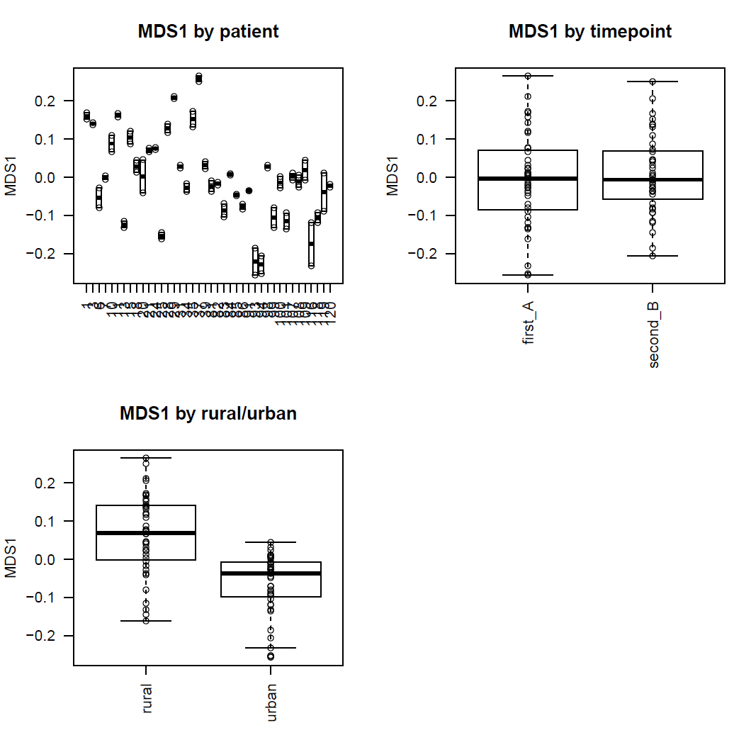
Visually, we see strong separation by
subject;
Little separation by timepoint
Strong separation by rural/urban

Slide 60
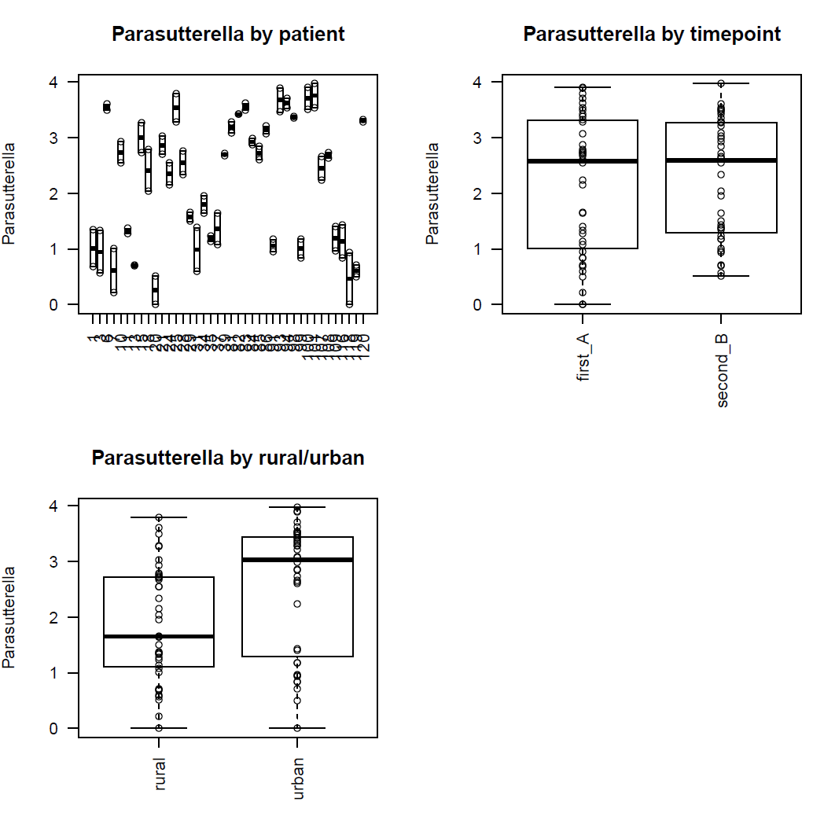
And in our PDF ball, we have this view for every non-rare taxa in our dataset
You can look at the pdf ball here: http://afodor.github.io/classes/ChapelHill2018/pdfBall.pdf

Slide 61
Normalizing your data
PCA Ordination
Graphing everything into one big PDF ball
Some Simple Statistical Models
Some Not So Simple Statistical Models

Slide 62
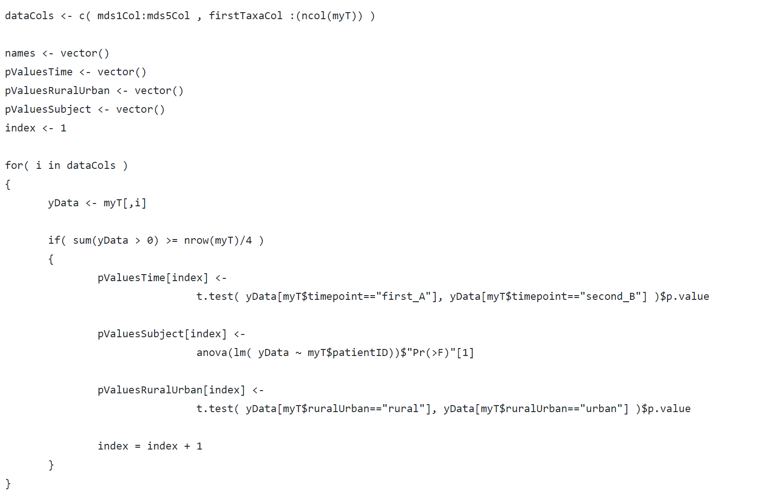
For each MDS axis or taxa, we can also run statistical tests (in addition to doing the visualization)
https://github.com/afodor/metagenomicsTools/blob/master/src/classExamples/ch2018/quickSimpleStats.txt

Slide 63
For each MDS axis or taxa, we can also run statistical tests (in addition to doing the visualization)
Data structures to hold our p-values
https://github.com/afodor/metagenomicsTools/blob/master/src/classExamples/ch2018/quickSimpleStats.txt

Slide 64
For each MDS axis or taxa, we can also run statistical tests (in addition to doing the visualization)
A t-test for our two timepoints
A one-way ANOVA for subject id
A t-test for our rural vs. urbal
https://github.com/afodor/metagenomicsTools/blob/master/src/classExamples/ch2018/quickSimpleStats.txt

Slide 65
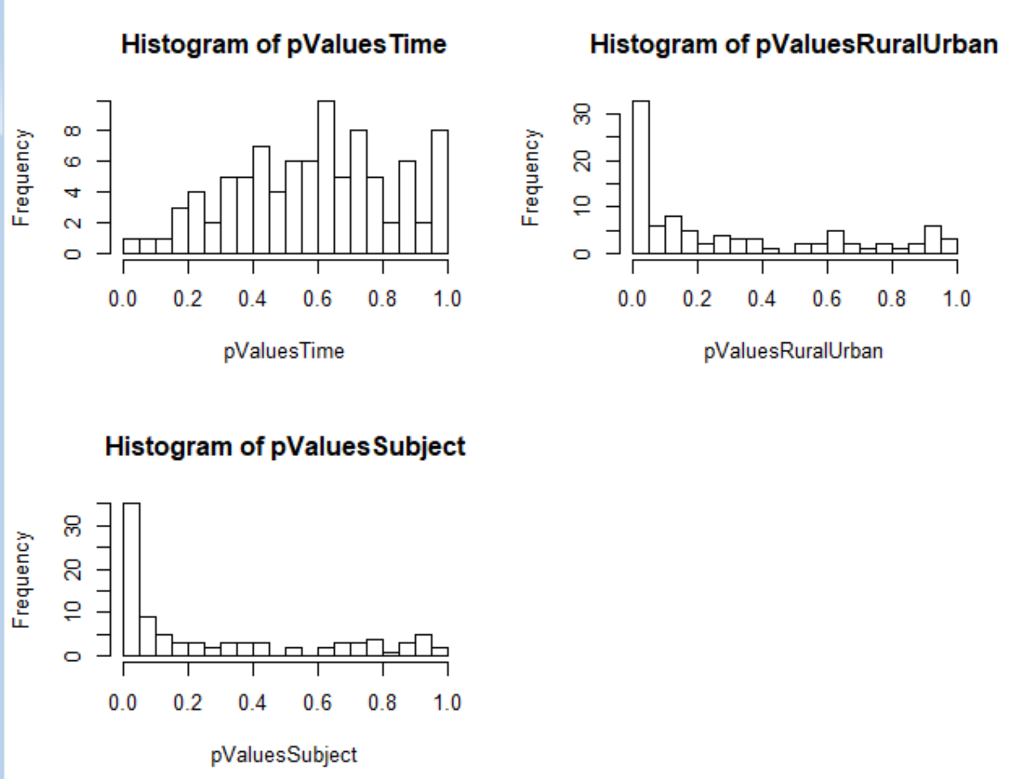
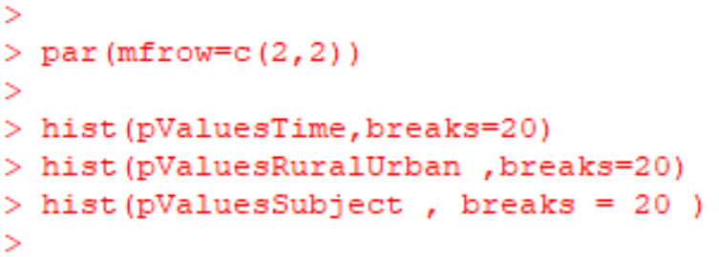
By examining the distribution of p-values, we can get a sense of the strength of associations with our meta-data

Slide 66
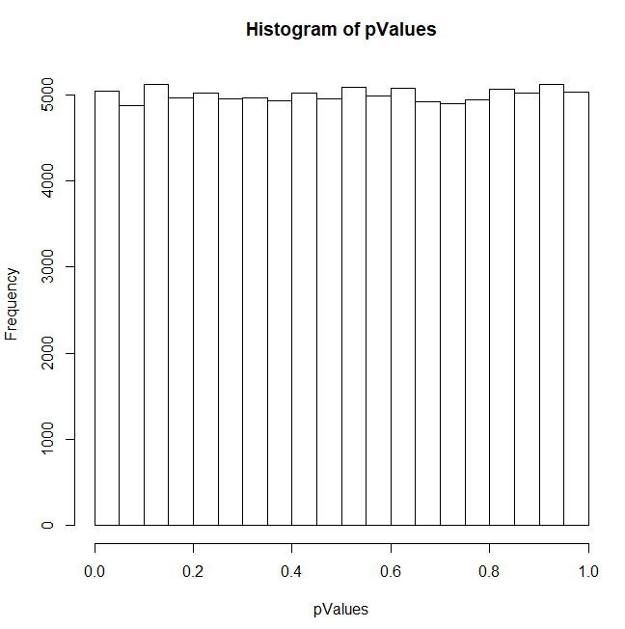
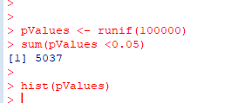
The histogram of all p-value is uniform when the null hypothesis is expected to be true!
Simulate an experiment where the null
hypothesis is always true…
Don’t use simple thresholds of p <0.05 for cases where you have evaluate multiple hypotheses!

Slide 67
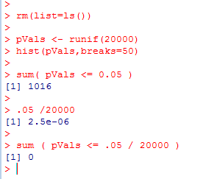
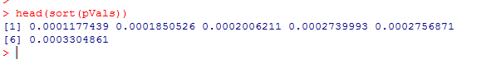
One alternative:
Use as a p-value threshold Bonferroni correction.
The desired threshold / number of tests.
In this case 0.05 / 20000 = 2.5e-06
None of our p-vals reach this threshold..
At this threshold, there is a 5% chance of any false positives

Slide 68
Bonferroni correction is sometimes considered too conservative for genomics experiments.
At small sample sizes, you might have few genes with p-values smaller than the
Bonferroni thresholds.
A less conservative alternative, false discovery rate.
At a 5% false discovery rate, we expect 5% of our hits to be false positives.
This is less conservative than Bonferroni correction, where there is a 5% chance
that any of our hits are false positives.

Slide 69
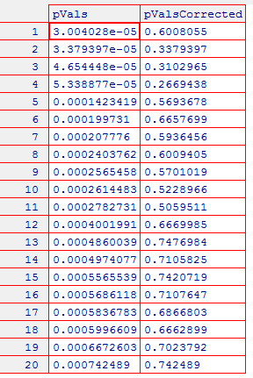
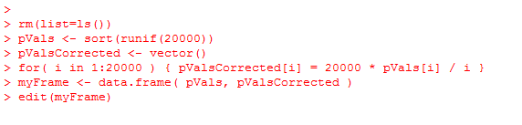
One straight-forward approach to finding genes at a given false-discovery rate
Benjamini and Hochberg FDR
1. Rank all the p-values (smallest first). The rank of each value = K
2. Calculate N * p / k
where N = the # of hypotheses that you are testing
p = the “raw” (uncorrected) p-value.
3. Start at the top of the list. Go down to N * p / k > threshold
(e.g. 0.10 for 10% FDR).
N * p = # of expected false positives at a given p-value
k = # of genes actually observed at that p-value

Slide 70
Note that for the first hit (smallest p-value),
Bonferroni correction is the same as BH FDR.
(Since if k=1,
N * p / K = N * p
which is the same as multiplying the p-value by the number of hypotheses to
do the correction)

Slide 71
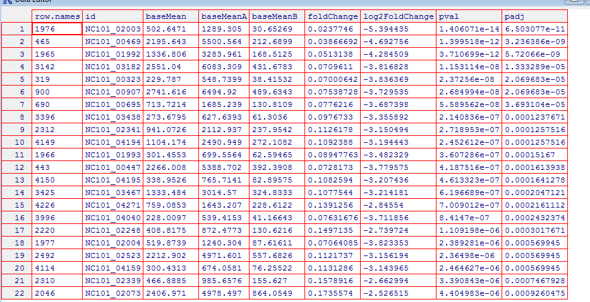
Here are example results from DeSeq (a popular RNA-seq analysis tool)…
FDR adjusted
p-values..
Raw p-values
You can access BH FDR correction from r with p.adjust( uncorrectedPValues, method=“BH”)

Slide 72
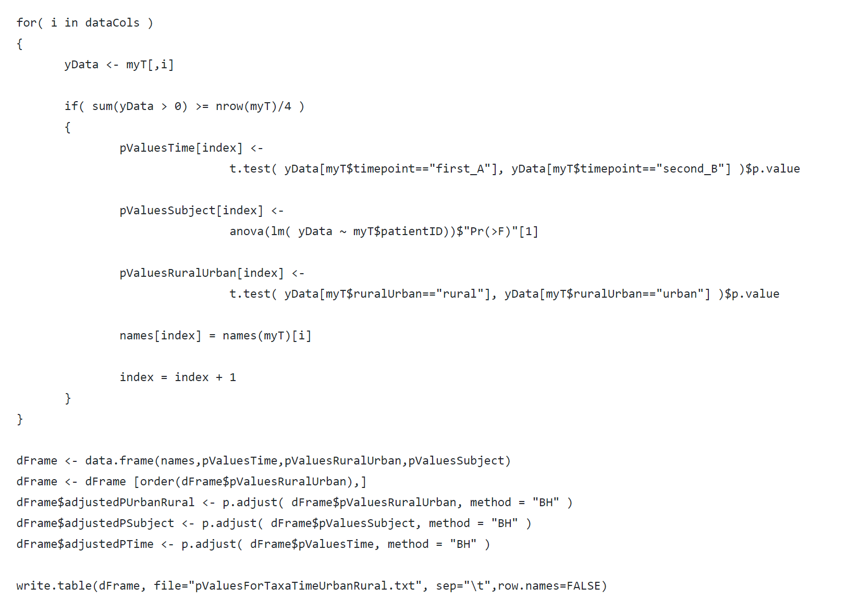
In our script, we can write out the adjusted and un-adjusted p-values for other applications to use
https://github.com/afodor/metagenomicsTools/blob/master/src/classExamples/ch2018/quickSimpleStats.txt

Slide 73
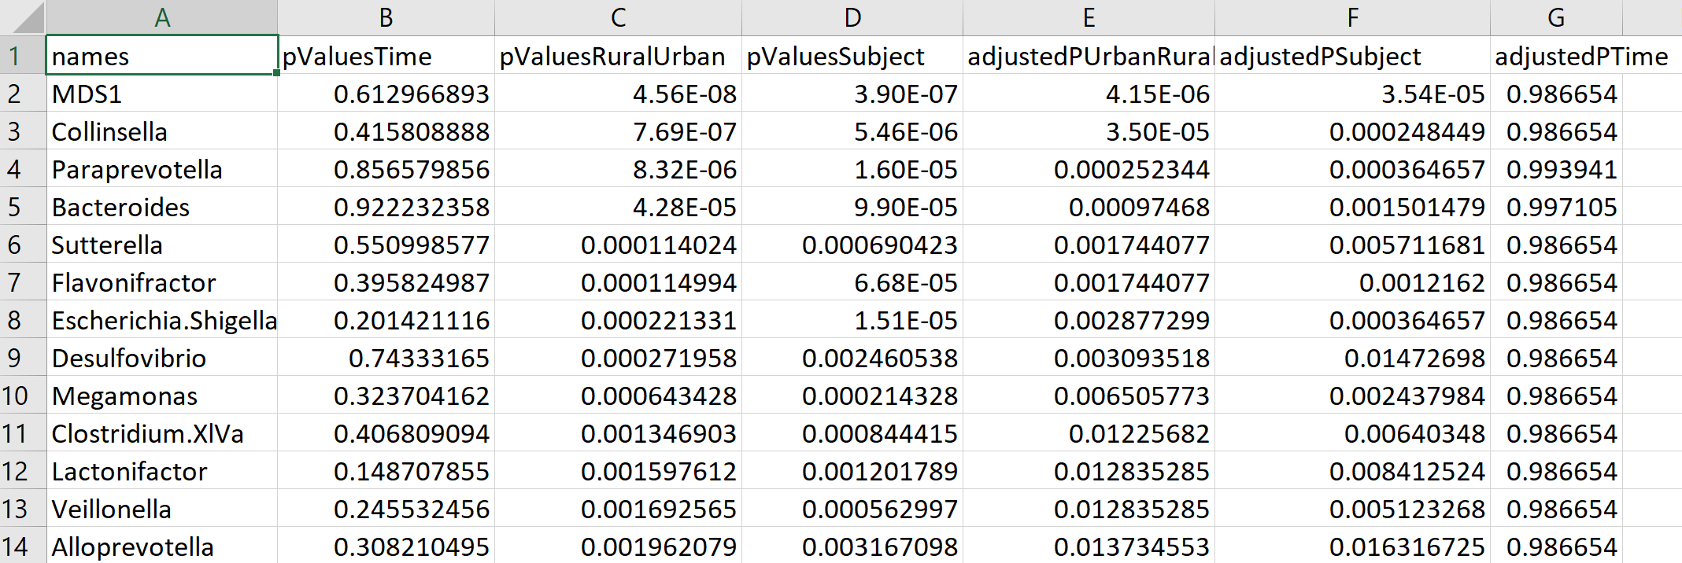
And we end up with our sorted list of taxa associated with our metadata

Slide 74
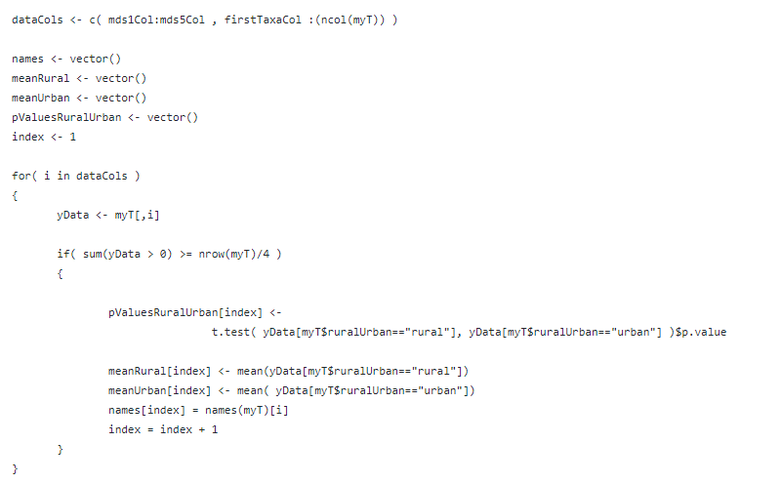
R gives you flexibility to make any view of the data you want….
https://github.com/afodor/metagenomicsTools/blob/master/src/classExamples/ch2018/meanVsGraph.txt

Slide 75


https://github.com/afodor/metagenomicsTools/blob/master/src/classExamples/ch2018/meanVsGraph.txt

Slide 76


This is a view I’ve used in multiple publications…
https://journals.plos.org/plosone/article?id=10.1371/journal.pone.0045001
The Adult Cystic Fibrosis Airway Microbiota Is Stable over Time and Infection
Type, and Highly Resilient to Antibiotic Treatment of Exacerbations
Rifaximin is associated with modest, transient decreases in multiple taxa in the gut microbiota
of patients with diarrhoea-predominant irritable bowel syndrome

Slide 77
Normalizing your data
PCA Ordination
Graphing everything into one big PDF ball
Some Simple Statistical Models
Some Not So Simple Statistical Models

Slide 78
Our simple t-test here is not
a “publishable” test as we ignore
that there are two timepoints for
each subject

Slide 79
One alternative: Do t-tests at both times separating the data
Another alternative: Mixed linear models
(http://afodor.github.io/classes/stats2018/Lecture18.pptx )

Slide 80
Model repeated samples from the same person, or people within hospitals, or mice within cages
Y = drug + (hospital) + error
Fixed Effects
Random Effects
Assumptions
Random effects are i.i.d.
Variance in groups are equal (homoscedasticity)
Hospital effects are normally distributed with a mean of 0
In effect, each hospital adds some value to the fixed effects and this
value is normally distributed with a mean of 0…

Slide 81



More information in two books (both can be downloaded from campus via springer links):
http://link.springer.com/
This book is more mathematical and very thorough;
a good reference
This book is more accessible and covers a broader
range of topics (beyond mixed-models)

Slide 82



There is a good deal of current interest in the literature in explicitly modeling the zeros
(these are often called “zero inflated models”)
This one is called the zero inflated beta distribution
3 parameter model
One parameter to absorb the zeros
Two parameters to fit the rest of the data

Slide 83
Learning more…

Slide 84


Ese
Essential for learning all the weirdness of R (does not try and teach stats!)

Slide 85
Helpful books on mixed linear models
http://link.springer.com/
This book is more mathematical and very thorough;
a good reference
This book is more accessible and covers a broader
range of topics (including zero-inflated models)

Slide 86



http://www.amazon.com/gp/offer-listing/025608338X/ref=sr_1_5_olp?ie=UTF8&qid=1357529565&sr=8-5&keywords=applied+linear+statistical+models&condition=used

Slide 87

Either edition of this book is fine, but new or used is going to be around $40.
It really is an outstanding book (but dense!). It is worth the investment of time and money

Slide 88

This is a great book, but is insanely over-priced!
If you think you will be implementing Bayesian stats in your pipelines, it might be worth having

Slide 89

Doing Bayesian Data Analysis: A Tutorial with R and BUG. John K. Kruschke. More approachable, but also not quite as clear or concise as the Bolstad book. Very nice chapters on Monte Carlo approaches to Bayesian analysis, but a bit heavy on the Bayesian proselytizing for my taste. Also quite expensive. Overall, though, a very engaging text. If you get the Google electronic edition, make sure that your device(s) can show the scanned versions (which are DRM’ed ) as the equations in the default view are illegible.
Be sure to read sample
chapters on the device
of your choice to make
sure formatting is ok
before purchasing…

Slide 90

Recommended:
It’s about $30-$40 and will make your life easier, but is not strictly required.
More useful as a reference than as a tutorial…

Slide 91

On-line resources:
Vassar stats book
http://vassarstats.net/textbook/
You will need at least one book that covers canonical statistics.
Start with this one (it is free) and then if it is not working for you, consider alternatives…

Slide 92


Legal download:
http://www-stat.stanford.edu/~tibs/ElemStatLearn/printings/ESLII_print10.pdf

Slide 93

A less mathematical treatment of the same material….
http://www-bcf.usc.edu/~gareth/ISL/

